Slide 1

Physics 1
Voronkov Vladimir Vasilyevich

Slide 2
Lecture 10
Direct current circuits.
Battery, internal resistance.
Resistors in parallel and in series.
Kirchhoff rules.

Slide 3
Battery
The emf of a battery is the maximum possible voltage that the battery can provide between its terminals.
Because a real battery is made of matter, there is resistance to the current within the battery.
This resistance is called internal resistance r.

Slide 4
Direct and Alternating current
There exist two types of current:
Direct current (dc) is the continuous flow of charge in only one direction. The whole lecture is devoted only to direct current circuits.
Alternating current (ac) is a flow of charge continually changing in both magnitude and in direction.

Slide 5
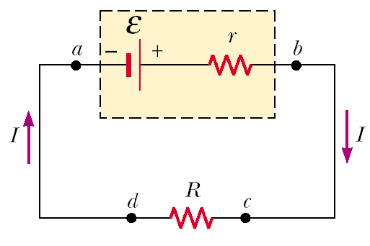
ε - emf
V – potential difference on the battery ( V= V_{b}-V_{a})
r – internal resistance of emf
R – external load
V_{b}-V_{a}: V= ε - IR
Circuit current: I= ε/(R+r)
Power output of the
battery is ε*I: ε*I = I²R + I²r

Slide 6
Power output of a Battery
ε*I = I²R + I²r
ε*I - power output of the battery.
I²R – power transferred to the external load
I²r – power loss by the internal resistance
So the power output of the battery to external resistance is accompanied by the power loss due to internal resistance.

Slide 7
Resistor
Resistor is a circuit element which is used to control the current level in the various parts of the circuit. It’s main property – it has constant resistivity for a wide range of potential differences.

Slide 8
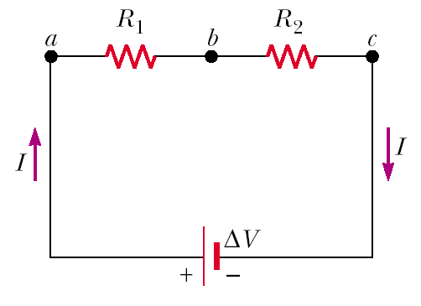
Resistors in Series
I_{ac}=I₁=I₂
V_{ac}=V₁ + V₂
R_{ac}=R₁ + R₂
Currents I₁ and I₂ are the same in both resistors because the amount of charge that passes through must also pass through in the same time inter interval.

Slide 9
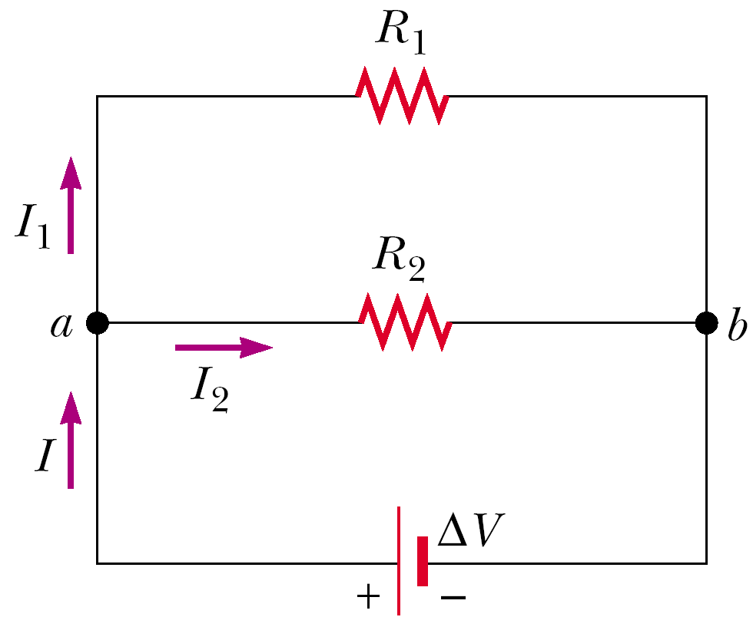
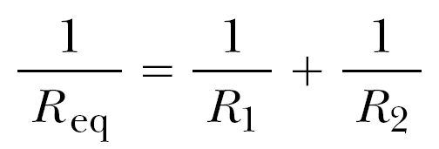
Resistors in Parallel
I=I₁+I₂
V_{ac}=V₁=V₂
When resistors are connected in parallel, the potential differences across the resistors are the same.

Slide 10
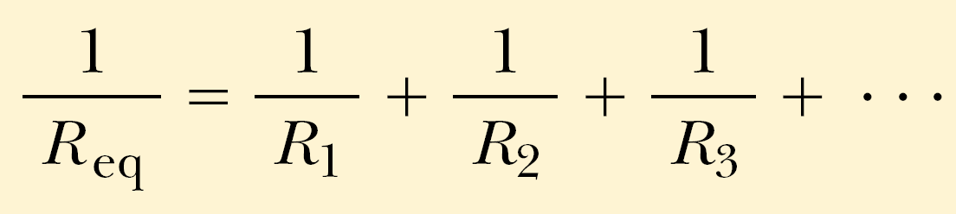
Any number of resistors
In series:
  I=I₁=I₂=I₃=…
  V=V₁ + V₂ + V₃ + …
  R_{ac}=R₁ + R₂ + R₃ + …
In parallel:
  I=I₁ + I₂ + I₃+ …
  V=V₁ = V₂ = V₃ = …

Slide 11
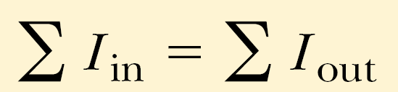
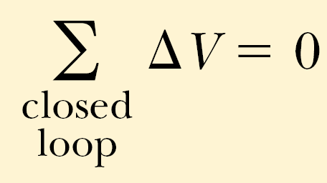
Kirchhoff’s Rules for Direct Current Circuits
Junction rule. The sum of the currents entering any junction in a circuit must equal the sum of the currents leaving that junction.
Loop rule. The sum of the potential differences across all elements around any closed circuit loop must be zero.

Slide 12
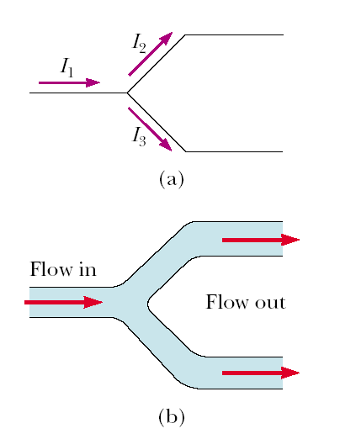
Junction Rule
I₁= I₂ + I₃
The Kirchhoff’s junction rule is an analogue for fluid current.
The junction rule is a consequence of the Charge conservation law.

Slide 13
Loop Rule Basis
Kirchhoff’s second rule follows from the law of conservation of energy. Let us imagine moving a charge around a closed loop of a circuit. When the charge returns to the starting point, the charge –circuit system must have the same total energy as it had before the charge was moved. The sum of the increases in energy as the charge passes through some circuit elements must equal the sum of the decreases in energy as it passes through other elements.
The potential energy decreases whenever the charge moves through a potential drop -IR across a resistor or whenever it moves in the reverse direction through a source of emf. The potential energy increases whenever the charge passes through a battery from the negative terminal to the positive terminal.

Slide 14
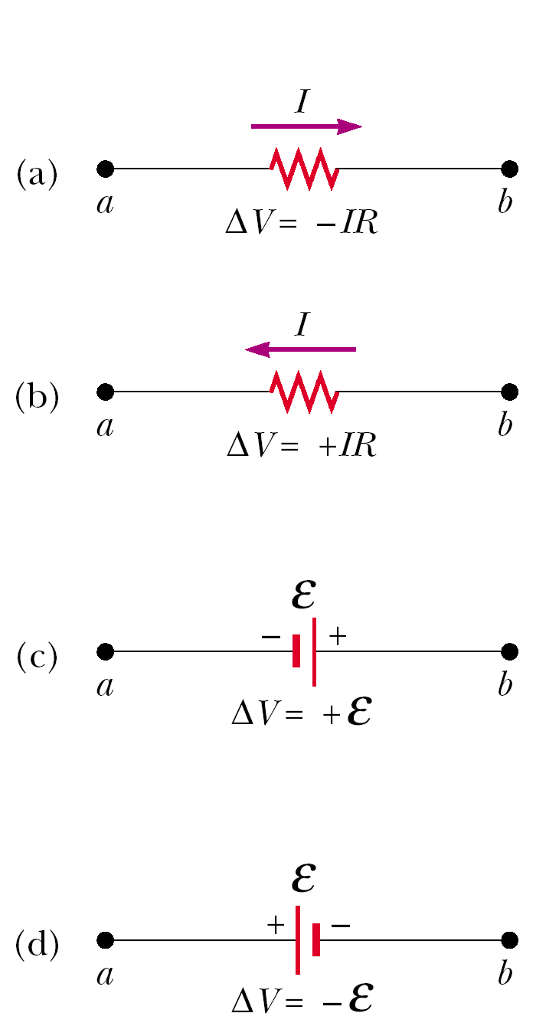
Loop rule
If a resistor is traversed in the direction of the current, the potential difference across the resistor –IR. (Fig. a)
If a resistor is traversed in the direction opposite the current, the potential differ- difference the resistor is +IR. (Fig. b)
If a source of emf (assumed to have zero internal resistance) is traversed in the direction of the emf (from - to +), the potential difference is + ε. The emf of the battery increases the electric potential as we move through it in this direction. (Fig. c)
If a source of emf (assumed to have zero internal resistance) is traversed in the direction opposite the emf (from + to - ), the potential difference - ε. In this case the emf of the batter battery reduces the electric potential as we move through it. (Fig. c)
In Figures a-d each element is traversed from left to right.

Slide 15
Kirchhoff’s rules validity
Kirchhoff’s rules are valid only for steady-state conditions - that is, the currents in various branches are constant.
Any capacitor acts as an open branch in a circuit; that is, the current in the branch containing the capacitor is zero under steady-state conditions.

Slide 16
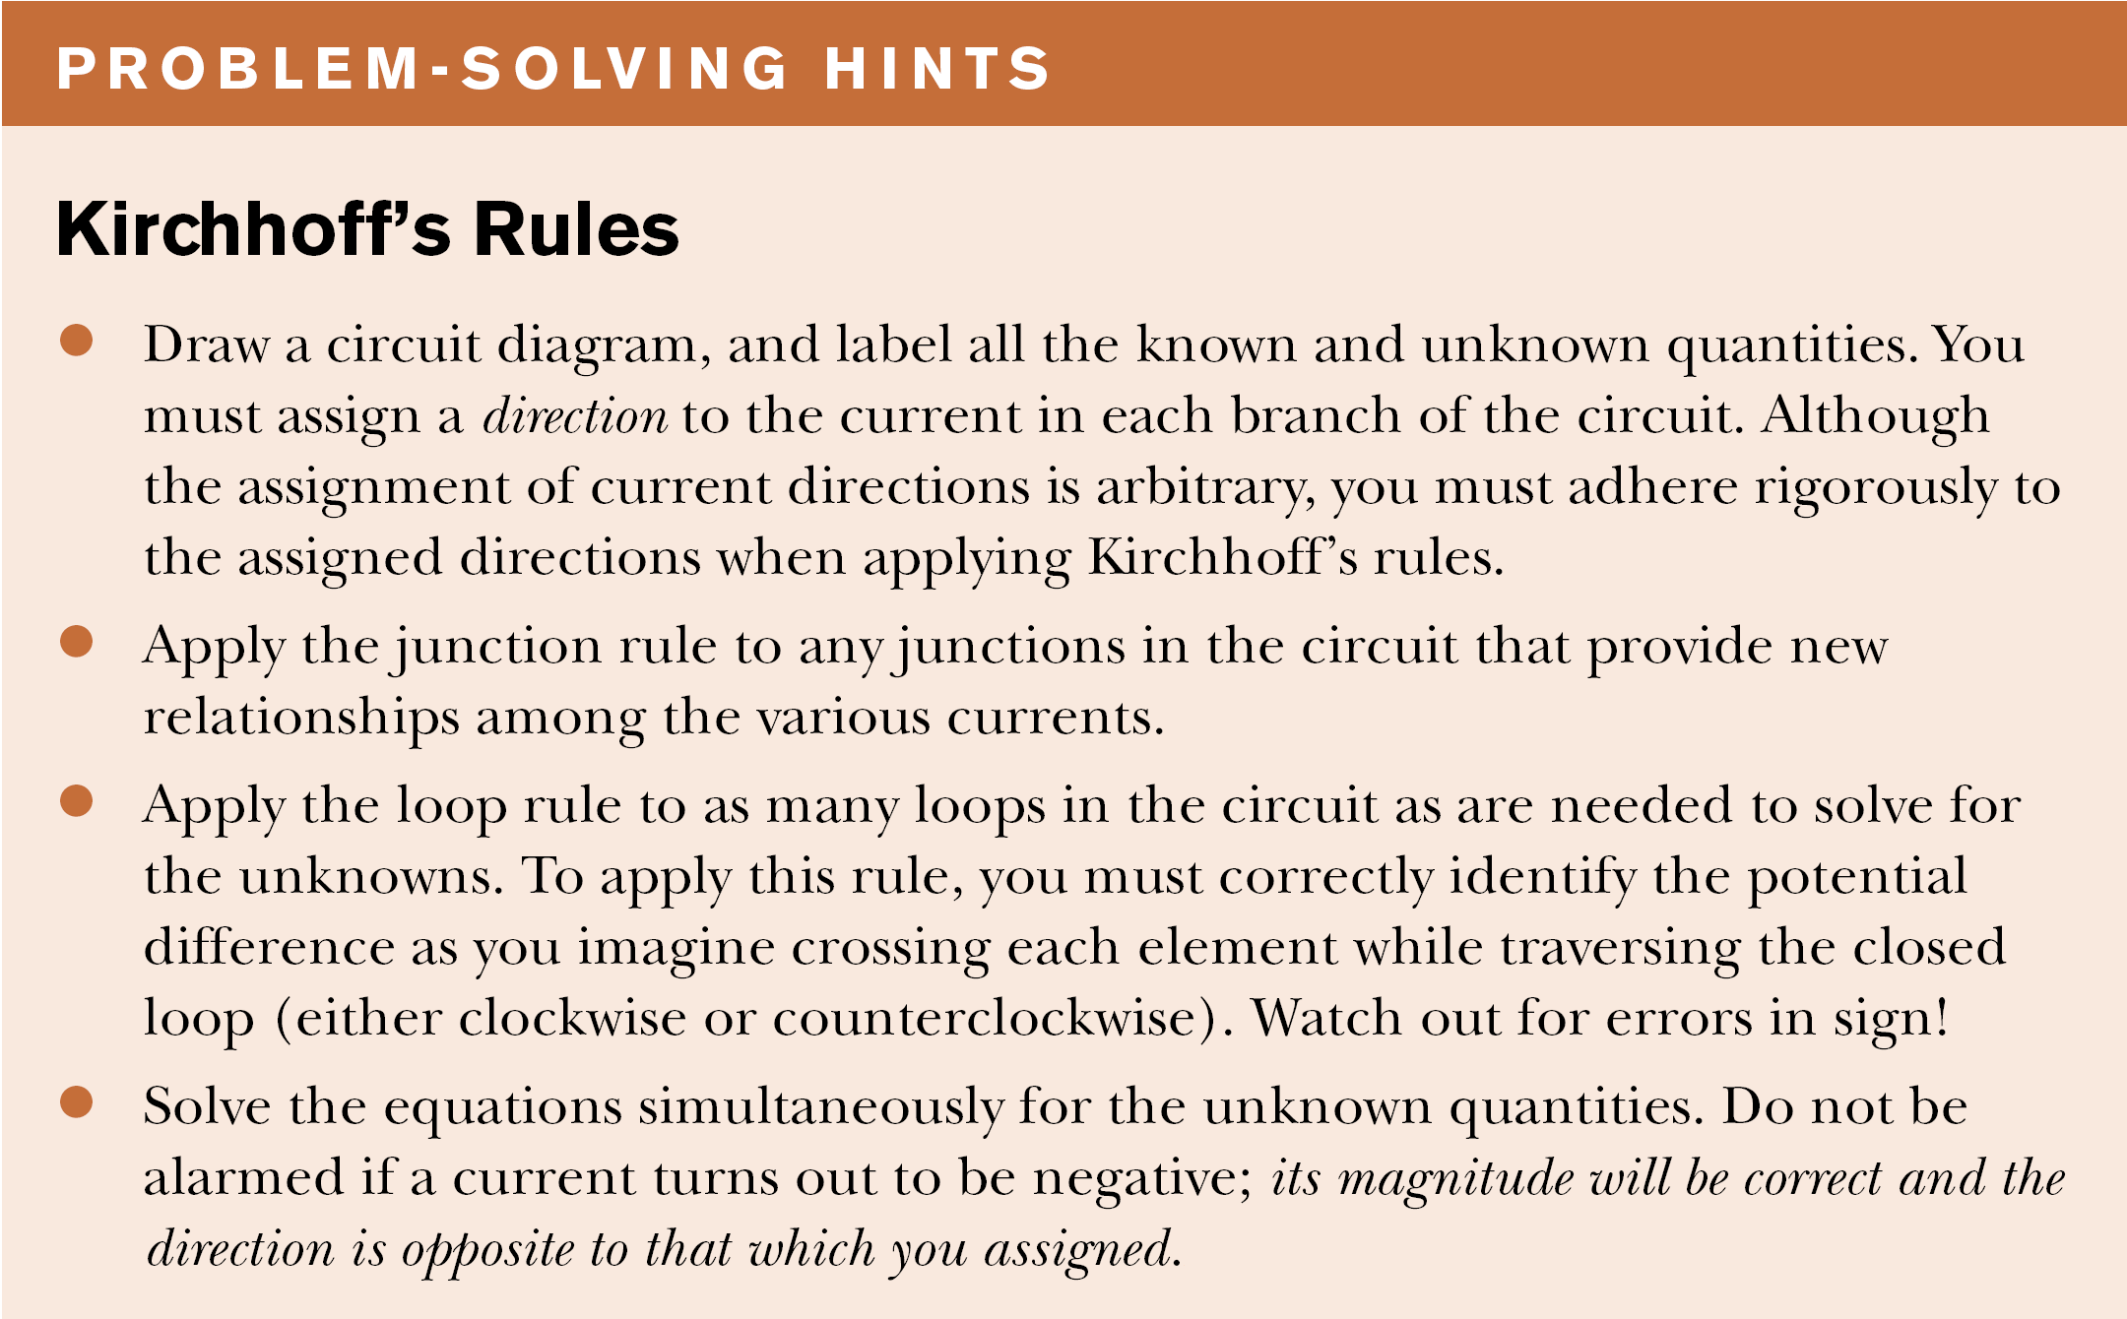

Slide 17
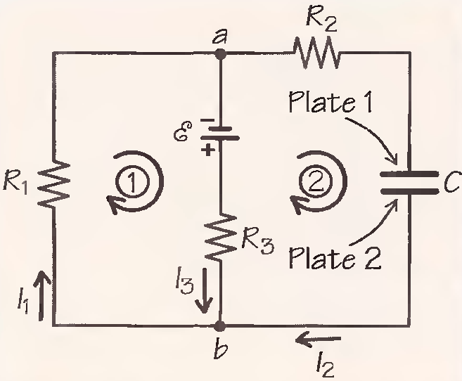
Example: a multiloop circuit
Given:
All currents are steady state, I₃=50mA,
ε=6V,
R₁=100 Ω,
R₂= 80 Ω,
C=2μF.
Find:
I₁, I₂, R₃, V_{C}.
V_{C} is the capacitor’s voltage
All currents are steady state means that there is no changes in currents. In steady-state condition the capacitor acts as an open switch despite the fact that it has voltage.

Slide 18
I₃=50mA,
ε=6V,
R₁=100 Ω,
R₂= 80 Ω,
C=2μF.
I₁, I₂, R₃, V_{C}= ?
So first we choose directions in the two circuits as it shown in the picture.
I₂=0, as the capacitor is not charging. =>
=> For junction b: I₃=I₁.
For loop 1: ε - I₃R₃ - I₁R₁ =>
R₃= ε/I₁ - R₁
For loop 2: ε - I₃R₃ -V_{C} = 0 =>
V_{C}= ε - I₃R₃ = ε - I₃R₃= I₁R₁

Slide 19
Types of Conductivity
Conductors are materials through which charge moves easily. (metals, electrolytes, superconductors, plasmas and some nonmetallic conductors such as graphite and conductive polymers)
Semiconductors are materials intermediate to conductors and insulators. (silicon, germanium, gallium arsenide, silicon carbide, orgainic cemiconductors)
Insulators are materials through which charge does not move easily. (glass, paper, Teflon, rubber, rubber-like polimers and most plastics)

Slide 20
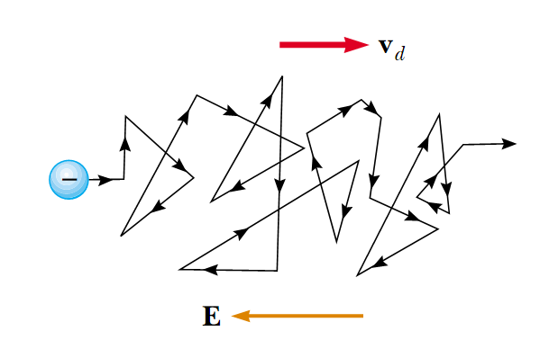
Drift speed of electrons
There is a zigzag motion of an electron in a conductor. The changes in direction are the result of collisions between the electron and atoms in the conductor. The net motion – drift speed of the electron is opposite the direction of the electric field.

Slide 21
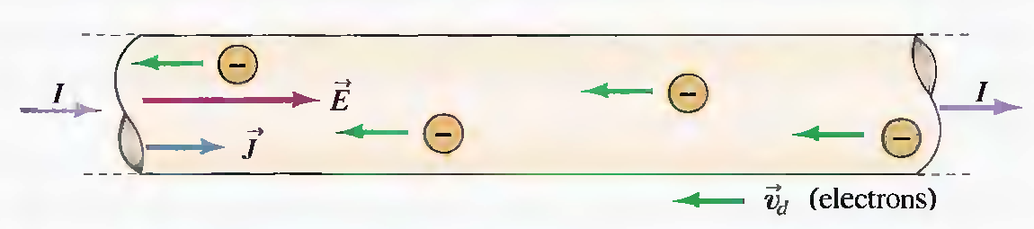
So when we consider electric current as a flow of electrons:
in reality there happens zigzag motion of free electrons in the metal:

Slide 22
Current in metals
Every atom in the metallic crystal gives up one or more of its outer electrons. These electrons are then free to move through the crystal, colliding at intervals with stationary positive ions, then the resistivity is:
ρ = m/(ne²τ)
n - the number density of free electrons,
m and e – mass and charge of electron,
– average time between collisions.

Slide 23
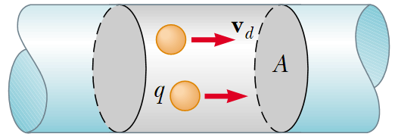
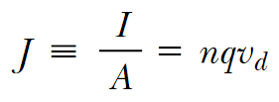

Resistivity
A conductor with current:
Current density:
I – electric current
A – the cross-sectional area of the conductor
v_{d} – drift speed
E = ρJ
ρ - resistivity

Slide 24
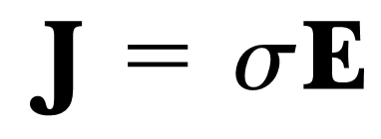
Conductivity
A current density J and an electric field E are established in a conductor whenever a potential difference is maintained across the conductor:
σ is conductivity:
σ = 1/ ρ.

Slide 25
Ohm’s law again
For many materials (including most metals), the ratio of the current density to the electric field is a constant σ that is independent of the electric field producing the current:
J = σE

Slide 26
Units in Si
Capacitance C F=C/V
Current I A=C/s
Resistance R Ohm=V/A
Electro motive force (emf) ε V

